Slide 1

Automotive Technology: A Systems Approach, 8e
Chapter 46: Suspension Systems
Rob Thompson and Jack Erjavec, Automotive Technology: A Systems Approach, 8th Edition. © 2025 Cengage. All Rights Reserved. May not be scanned, copied or duplicated, or posted to a publicly accessible website, in whole or in part.

Slide 2
Chapter Objectives (1 of 2)
46.01 Describe types of vehicle construction and how it relates to the suspension system.
46.02 Identify common suspension components.
46.03 Identify types of independent and non-independent suspension systems.
46.04 Perform a general front-suspension inspection.
46.05 Diagnose common suspension concerns, such as excessive bounce, body roll, and noises.

Slide 3
Chapter Objectives (2 of 2)
46.06 Identify how to service and repair front suspension components.
46.07 Identify the three basic types of rear suspensions and know their effects on traction and tire wear.
46.08 Perform repairs on rear suspension systems.
46.09 Describe the advantages and operation of the three basic electronically controlled suspension systems: level control, adaptive, and active.

Slide 4
Frames
46.01 Describe types of vehicle construction and how it relates to the suspension system.
Body Over Frame
  The body and all major parts are bolted to the frame.
  Currently only used on trucks and SUVs.
Unitized Body
  Tends to be more tightly structured.
  Is designed to transmit impact energy throughout the vehicle.
  Is significantly lower in weight.

Slide 5
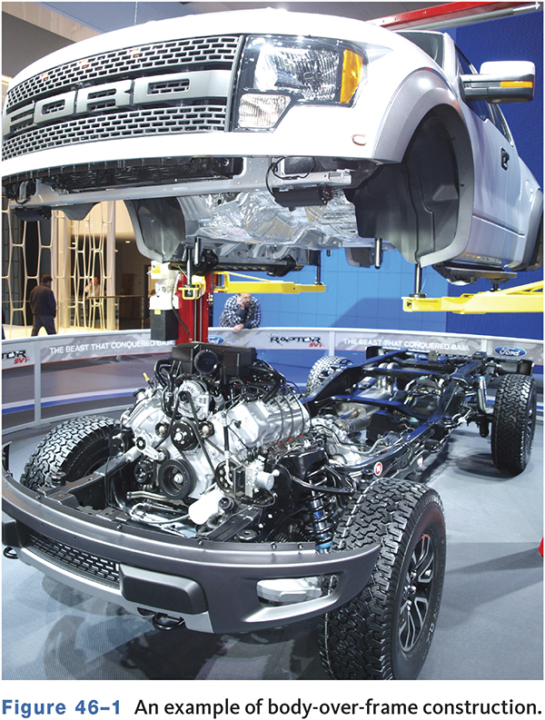
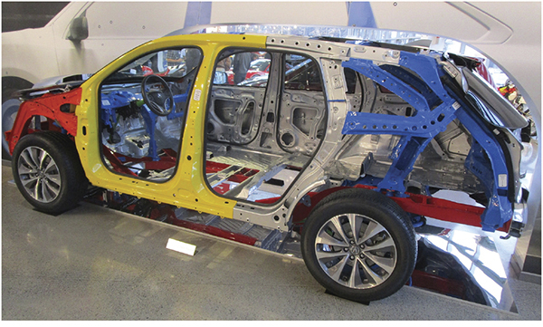
Conventional and Unibody

Slide 6
Springs
46.02 Identify common suspension components.
Carry vehicle weight.
Absorb road shock forces.
Maintain correct ride height.
The amount the compress under load is called spring rate.
Spring compression is called jounce.
Spring extension is called rebound.

Slide 7
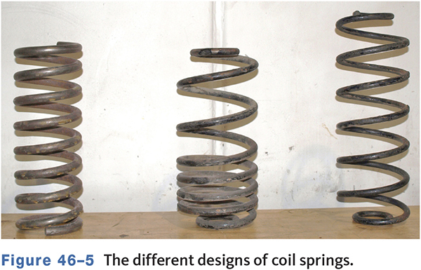
Coil Springs

Slide 8
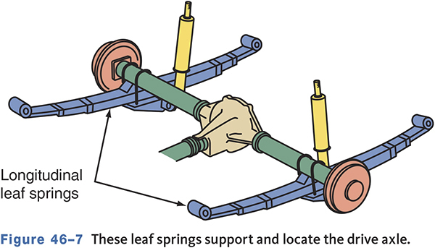
Leaf Springs
Found mostly on trucks and vans.

Slide 9
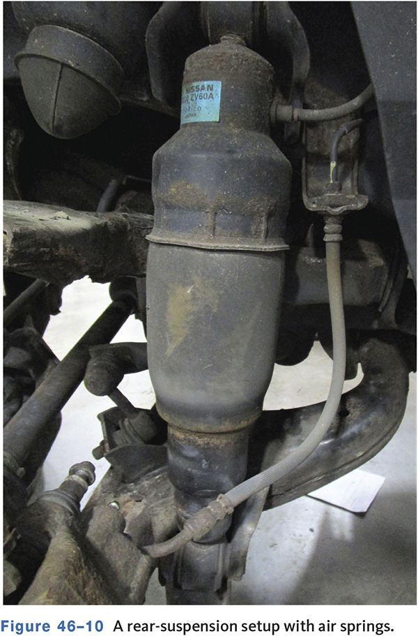
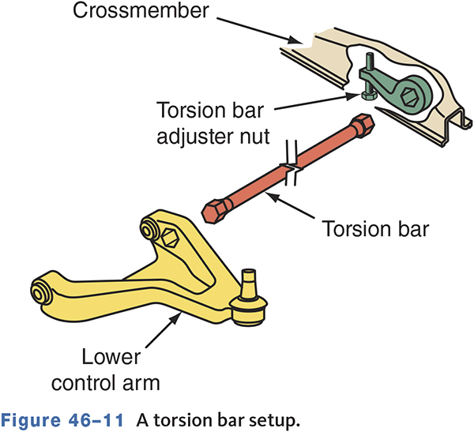
Air Springs and Torsion Bars

Slide 10
Torsion Bar Suspension Systems
Torsion bars perform like a coil spring.
Instead of compressing, a torsion bar twists.
Due to prestressing, they are directional.
Many late model trucks and SUVs use torsion bars.

Slide 11
Shock Absorbers
Dampen spring movement.
The faster a shock moves, the more resistance it has to movement.
Typically has more resistance to extension than compression.
Gas charged shocks are effective at limiting fluid foaming.

Slide 12
Types of Shock Absorbers
Hydraulic
  Uses hydraulic oil moved between two chambers.
Gas-charged
  Uses nitrogen gas as well as oil.
Air
  Uses air chambers to control the height of the shock.

Slide 13
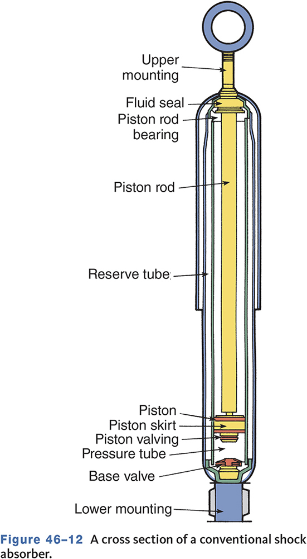
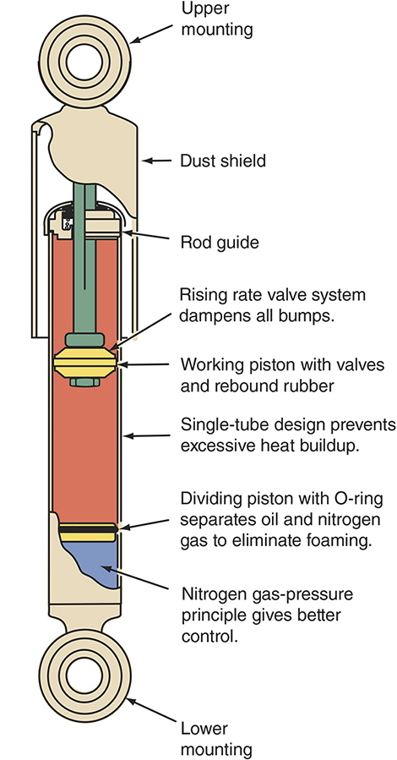
Hydraulic Shocks

Slide 14
Stabilizer Bars (1 of 2)
Also called a sway bar or antisway bar.
Reduces body roll or lean.
Typically a one-piece U-shaped steel bar.
Held to the control arms or strut with links.
Used on the front and rear suspensions.

Slide 15
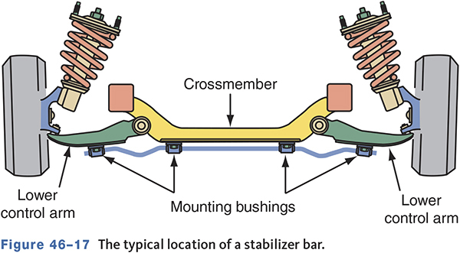
Stabilizer Bars (2 of 2)

Slide 16
Bushings
Used on stabilizer bars, controls arms, radius arms, and strut rods.
Good for pivots, minimizing lubrication points, and allow for slight misalignments.
Allow movement between components.
Bushing movement produces heat.
Worn bushings allow suspension movement.

Slide 17
Knowledge Check (1 of 4)
Technician A says the springs carry the weight of the vehicle and absorb bumps in the road. Technician B says the shock absorbers are used to carry the weight of the vehicle.
Who is correct?

Slide 18
Knowledge Check Answer (1 of 4)
Technician A says the springs carry the weight of the vehicle and absorb bumps in the road. Technician B says the shock absorbers are used to carry the weight of the vehicle.
Who is correct?
Answer: Technician A only

Slide 19
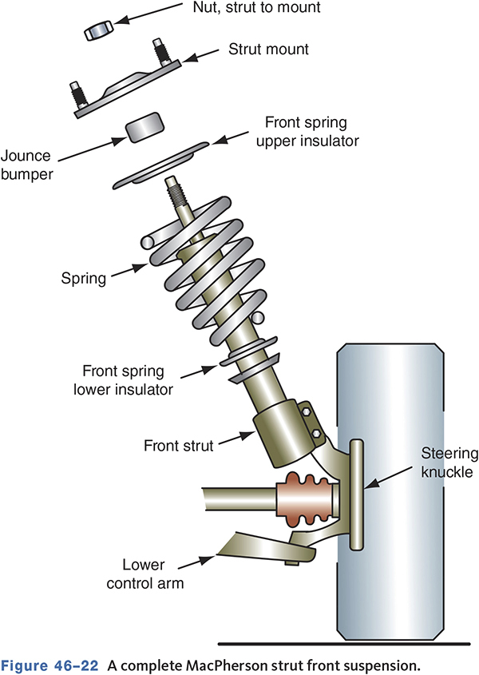
MacPherson Strut Suspensions
46.03 Identify types of independent and non independent suspension systems.
Spring.
Shock absorber.
Upper suspension locator and steering pivot.

Slide 20
Strut Mounts
Dampen vibrations.
Secure the strut in position.
Include a bearing or bushing.
Worn mounts can cause noise, poor handling, and damage to the strut.

Slide 21
Lower Suspension Components
Lower strut suspension mounts to the frame.
A lower control arm and ball joint are used.
The lower ball joint is a friction joint.
  Used to stabilize the steering and retard shimmy.
Sway bars are retained in strut suspensions.
Coil springs are used in all strut suspensions.

Slide 22
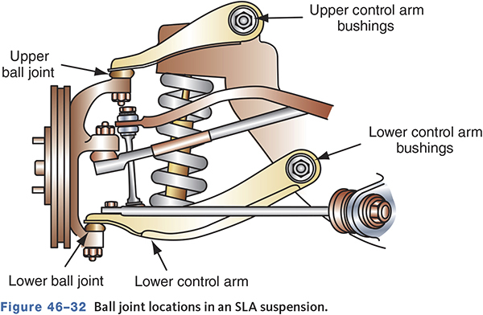
Short-Long Arm Suspension
Each wheel is connected independently to the frame.
The upper arm pivots in a shorter arc.
The top of the wheel moves slightly, but tire’s contact with the road remains constant.

Slide 23
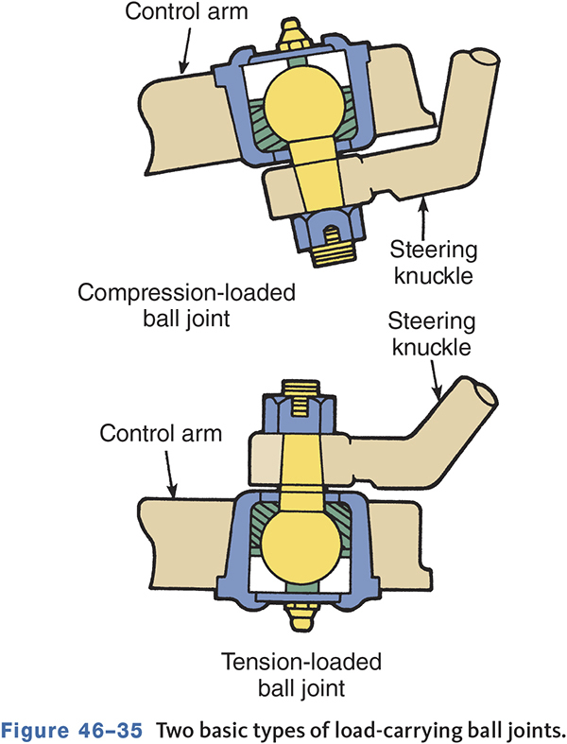
Ball Joints
Connects the steering knuckle to the control arms.
Are either load carrying or are followers
  Load carrying joints support the vehicle’s weight.
  Following or friction joints a steering pivot.

Slide 24
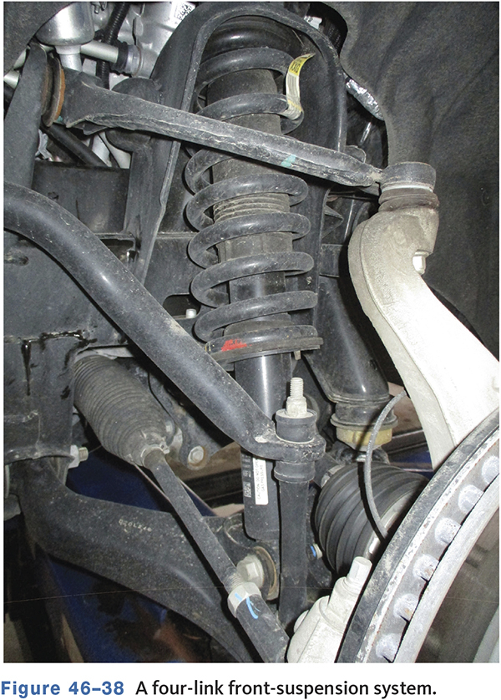
Four-Link or Multilink Front Suspension
This style optimizes ride quality and movement.
The influence of drive forces on the steering is minimal.

Slide 25
Knowledge Check (2 of 4)
Technician A says the ball joint located on the control arm with the spring is the friction joint.
Technician B says the ball joint on MacPherson strut suspensions is a load-carrying joint.
Who is correct?

Slide 26
Knowledge Check Answer (2 of 4)
Technician A says the ball joint located on the control arm with the spring is the friction joint.
Technician B says the ball joint on MacPherson strut suspensions is a load-carrying joint.
Who is correct?
Answer: Neither Technician A nor B

Slide 27
Basic Front-Suspension Diagnosis
46.04 Perform a general front-suspension inspection.
Test drive to verify the customer complaint.
Inspect the tires, chassis, and underbody.
Check for aftermarket modifications.
Check for signs of overloading or sagging.
Inspect wheel bearings, front and rear suspension parts, shocks, and bushings.

Slide 28
Shock/Strut Bounce Test
46.05 Diagnose common suspension concerns, such as excessive bounce, body roll, and noises.
Push the bumper down two or three times.
The vehicle should oscillate about one and a half times then settle.
Excessive bounce indicates the shocks are worn and need replaced.
Listen for noises while testing.

Slide 29
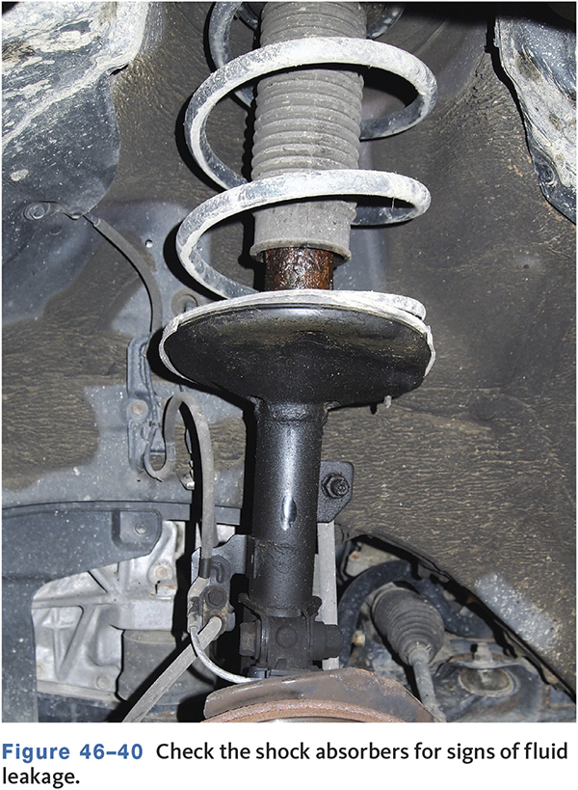
Signs of Shock Failure
More difficult steering and handling.
Rough braking.
Excessive bouncing after stops.
Unusual tire wear patterns.
Bottoming out springs.

Slide 30
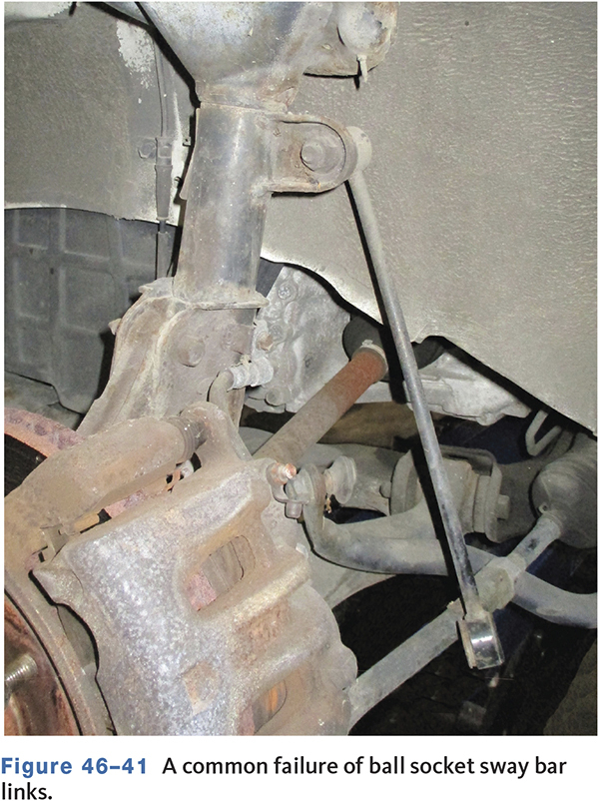
Excessive Body Roll
Can be caused by worn out shocks.
Broken sway bar links allow excessive body roll.

Slide 31
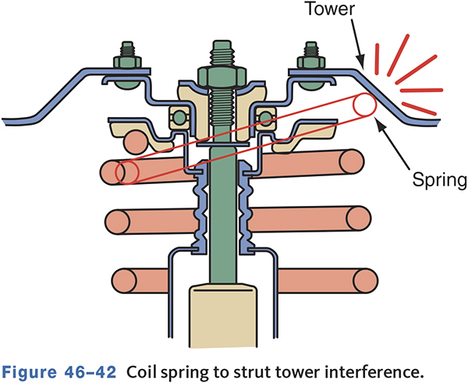
Noises
Abnormal noises can be caused by
  Tires
  Shocks
  Bushings
  Strut mounts
  Ball joints

Slide 32
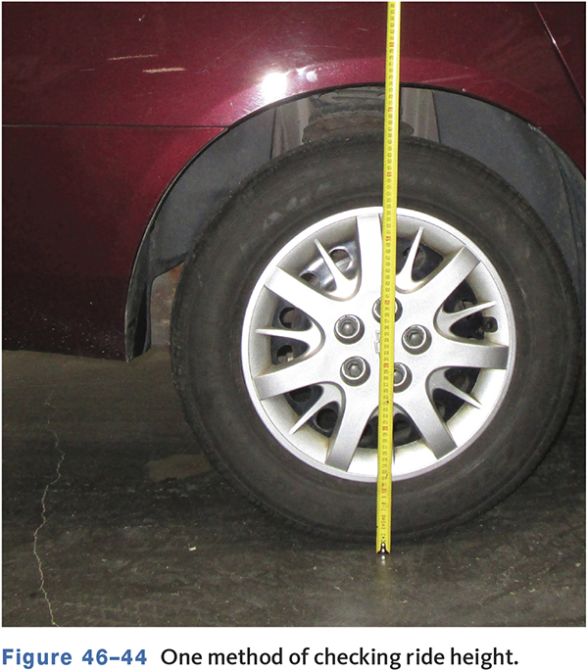
Chassis Height Specifications
Inspect for sag, damaged or worn bumpers, or shiny spring coils.
Measure height at specific locations.

Slide 33
Front-Suspension Component Servicing
46.06 Identify how to service and repair front suspension components.
Coil Springs
  Require no adjustment.
  Weak springs sag and affect ride height.
  Can break from overloading.
  To replace, support the lower control arm and attach a spring compressor to safely handle the spring.

Slide 34
Ball Joints
Check wear indicator if applicable.
Check for wear with a dial indicator
  Most joints should have no slop or play.
Load-carrying joint is on same control arm as the spring.

Slide 35
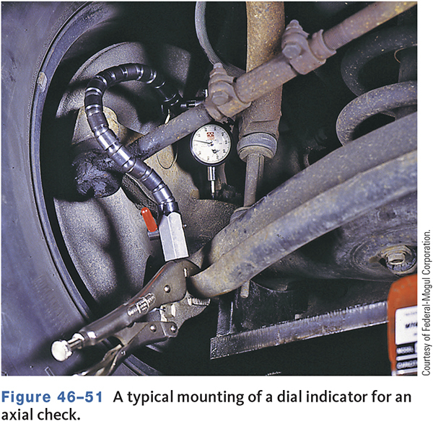
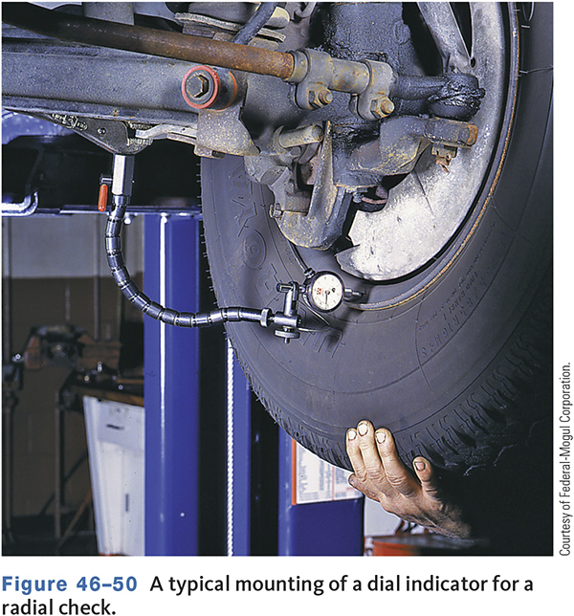
Checking Ball Joint Wear

Slide 36
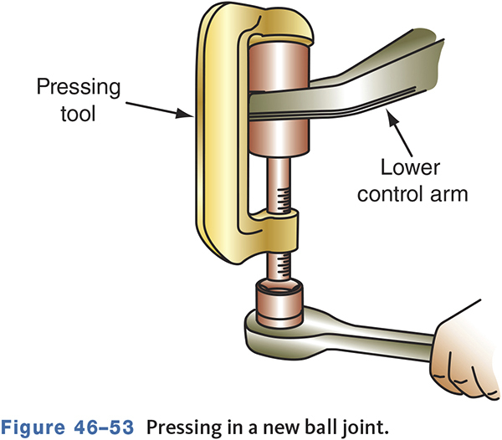
Replacing Ball Joints
Ball joints may be press fit, riveted, bolted, or threaded to the control arm.
Rivets are removed and replaced with bolts and nuts.
Press fit joints require a press for installation.

Slide 37
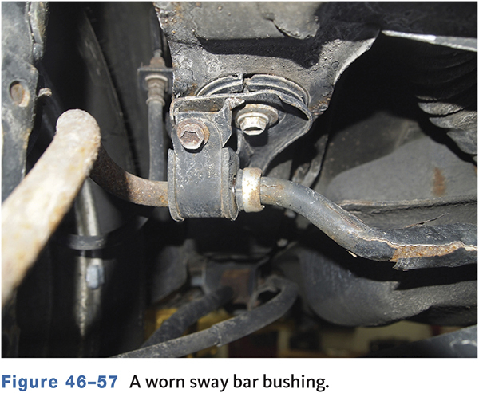
Sway Bar Bushings
Broken links allow excessive body roll.
Worn bushings can allow sway bar to knock.

Slide 38
Shock Absorbers
Will gradually wear and change vehicle stability, handling, and rideability.
Common problems are
  Steering and handling are more difficult.
  Braking is not smooth.
  Bouncing is excessive after bumps and stops.
  Tire wear patterns are unusual, especially cupping.
  Springs are bottoming out.

Slide 39
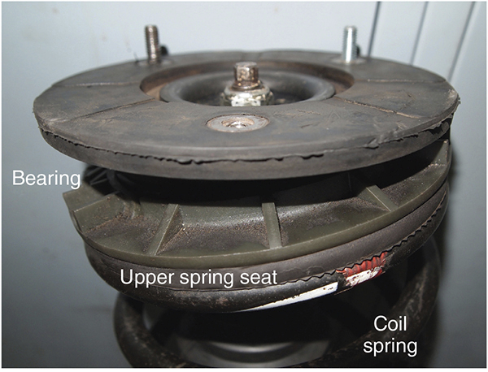
MacPherson Strut Suspension
The strut receives a large amount of vertical and horizontal force.
Check closely for leaks, bent shaft, and poor damping.
During replacement, check the strut pivot bearing.

Slide 40
Knowledge Check (3 of 4)
While conducting a bounce test: Technician A says that the bumper should be pushed two or three times downward with considerable weight applied on each corner of the vehicle.
Technician B says that one free upward bounce should stop the vertical chassis movement if the shock absorber or strut provides proper spring control.
Who is correct?

Slide 41
Knowledge Check Answer (3 of 4)
While conducting a bounce test: Technician A says that the bumper should be pushed two or three times downward with considerable weight applied on each corner of the vehicle.
Technician B says that one free upward bounce should stop the vertical chassis movement if the shock absorber or strut provides proper spring control.
Who is correct?
Answer: Both Technicians A and B

Slide 42
Rear-Suspension Systems
46.07 Identify the three basic types of rear suspensions and know their effects on traction and tire wear.
Three basic types
  Live axle
  Semi-independent
  Independent
There are many variations within the three basic types.

Slide 43
Live-Axle Rear Suspensions
Leaf spring live-axle
  Leaf spring mounted at right angle to the axle.
  Large amount of unsprung weight.
  Axle tramp possible under hard acceleration.
Coil spring live-axle
  Used with forward and lateral control arms.
  Some vehicles use a track bar and a torque tube.

Slide 44
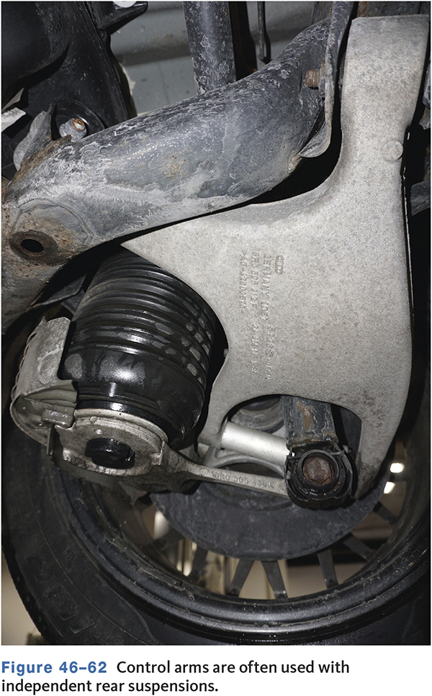
Independent Suspension
Found on many FWD and RWD models.
Improves ride and traction.
Many variations with control arms and types of springs.
Commonly used with rear struts.

Slide 45
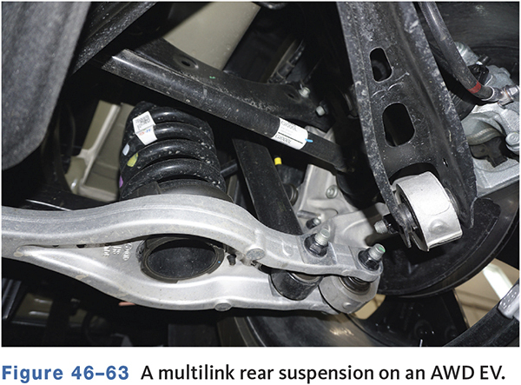
Multilink Rear Suspension
Uses several control arms to guide the wheel.
Types vary by manufacturer and desired ride and handling qualities.
May use double-wishbone, trailing-link double-wishbone, and trapezoidal-link rear suspensions.

Slide 46
Servicing Independent Suspension Systems
46.08 Perform repairs on rear suspension systems.
Most of the servicing techniques for rear independent suspension systems—except coil, control arm, and strut removal and installation—are similar to other front- and rear-suspension parts.
Check the service information for all inspection and repair techniques of the vehicle’s independent rear system.

Slide 47
Knowledge Check (4 of 4)
Technician A says a live axle is a type of independent rear suspension.
Technician B says FWD vehicles have live axles as part of the rear suspension.
Who is correct?

Slide 48
Knowledge Check Answer (4 of 4)
Technician A says a live axle is a type of independent rear suspension.
Technician B says FWD vehicles have live axles as part of the rear suspension.
Who is correct?
Answer: Neither Technician A nor B

Slide 49
Types of Electronic Suspensions
46.09 Describe the advantages and operation of the three basic electronically controlled suspension systems: level control, adaptive, and active.
Adaptive Systems
  Typically use electronic shocks with variable valving.
Load-Leveling Systems
  Use air shocks in the rear to compensate for vehicle load.
Fully Active Systems
  Use hydraulic actuators as both spring and shock absorber.

Slide 50
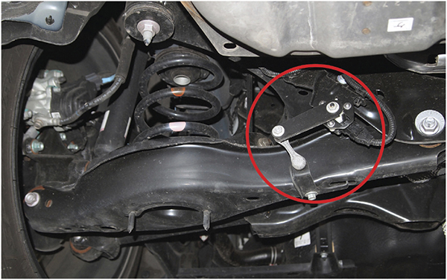
A Ride Control Sensor

Slide 51
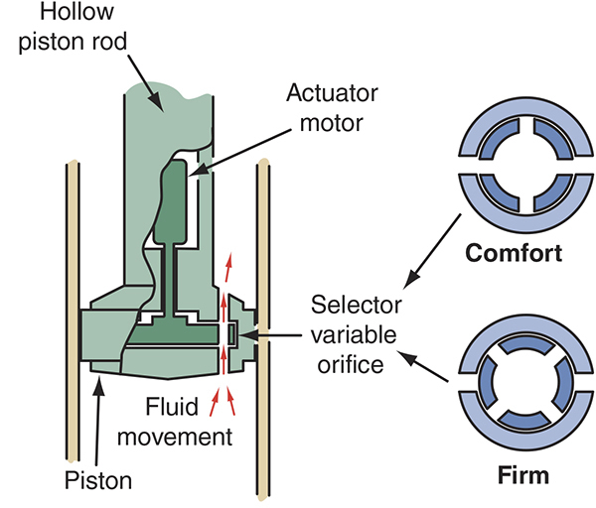
Computer Command Ride Strut

Slide 52
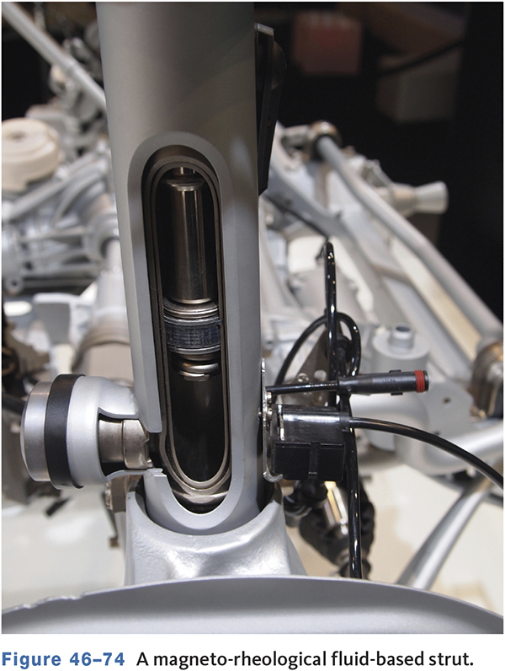
MagneRide
Regulates fluid flow by a variable magnetic field produced by a coil in the shock.
Shocks filled with a magneto-rheological fluid.
Current flow changes the fluid’s viscosity.

Slide 53
Diagnosis
Scan tools or special testers are used.
Check DTCs and basic visual inspection items.
Check the DTC charts to see if the DTCs match the symptoms exhibited by the vehicle
  Follow the troubleshooting chart for each DTC.
Attempt to control system outputs with the scan tool.

Slide 54
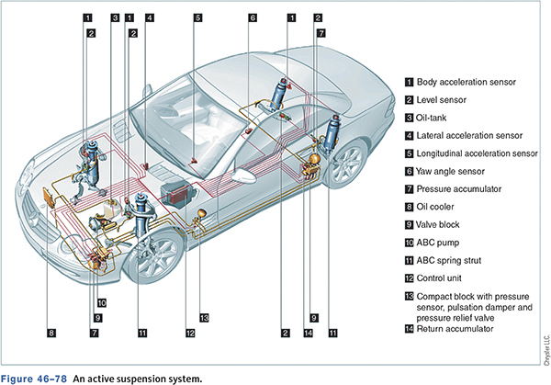
Active Suspension Components

Slide 55
Chapter Reflection
Write down The concept from this chapter that challenged you the most.
Describe what made the concept difficult for you and the steps you took to improve your understanding.
How could you help another learner who was struggling with the same concept.
Use 100–150 words in your answer.

